Slide 1
Welcome to our Presentation
Motion Sensing light with Arduino

Slide 2
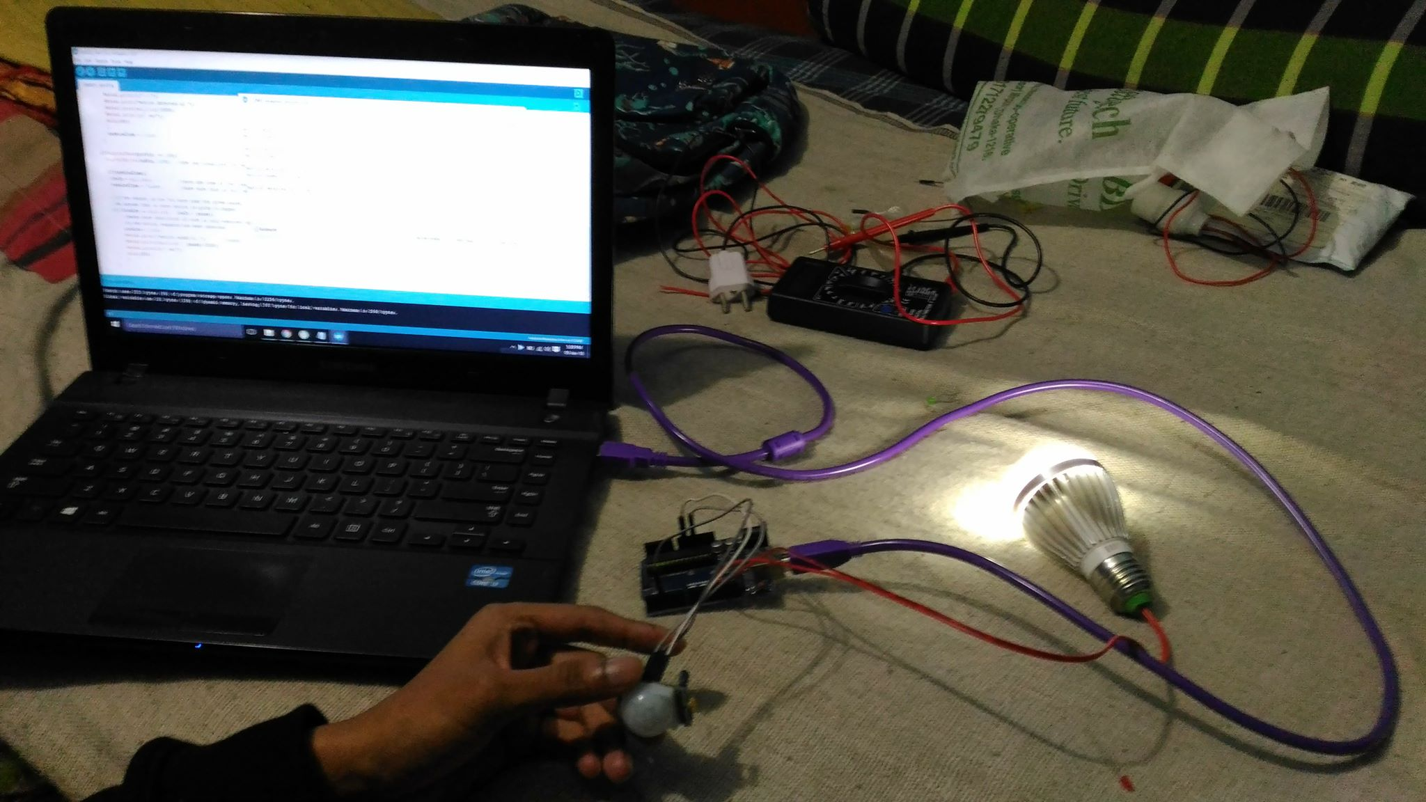
About our Project
Our project is Automatic motion sensing light with Arduino uno.
It’s a Home Automation system

Slide 3
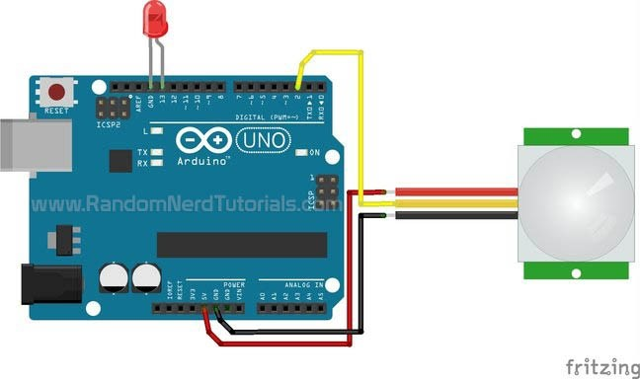
Diagram of our Project
we take used in our project
Arduino Uno
PIR Sensor
4v led light
Some jumper cable
Connections :
PIR sensor has 3 pin : vcc(left), output pin(middle) & ground pin(right).
We connect vcc pin to arduino 5v pin, grd pin to grd pin , output pin to digital pin 3. and 4v led to positive is in 13 pin and negative to grd.

Slide 4
Flow chart
Start
PIR
Sensor
If Detect Motion
If Doesn’t Detect Motion
LED ON
STOP
END Detection

Slide 5
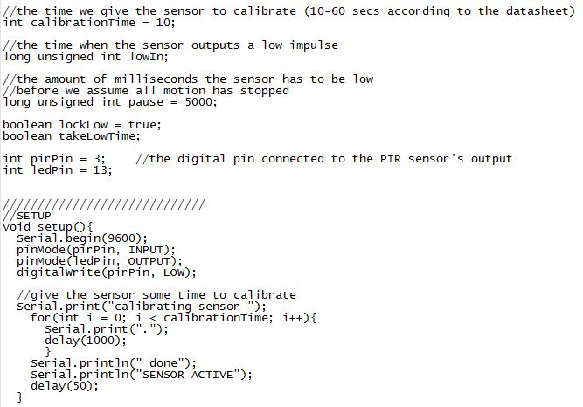
Code

Slide 6
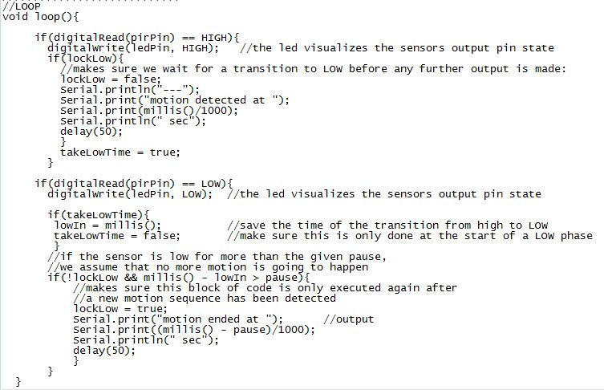
Code

Slide 7

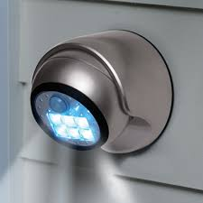
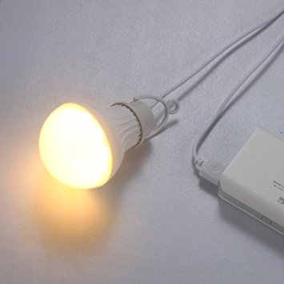
Why we are better ?
We use 4v LED bulb which consume a very low amount of electricity .
Our Device is much more cheaper than the Market selling embedded system motion sensing light.
We can embedded the whole device with the sensor in a little box, so its also a space efficient .
We can use our project in a extreme emergency case such as Light out , Building on Fire , outside the balcony at night , and catching the thief using Alarm too.

Slide 8
Cost of the project
Our Project Market sell Embedded system
Arduino - 450 MI motion sensor light - 2000
PIR Sensor - 120 Mr Beam power M.Light - 1500
Jumper cable - 50 ( set ) lextreme solar M.sensor - 5000
4v LED Bulb – 80 sangled smart motion sensor - 6000
Addition case we need RELAY for higher then 5v bulb and the main power source plug and socket which cost maximum 200 .
All in all , we are best because our project is under 700 but the others are more then 1000 . So we are cheap and power efficiant.

Slide 9
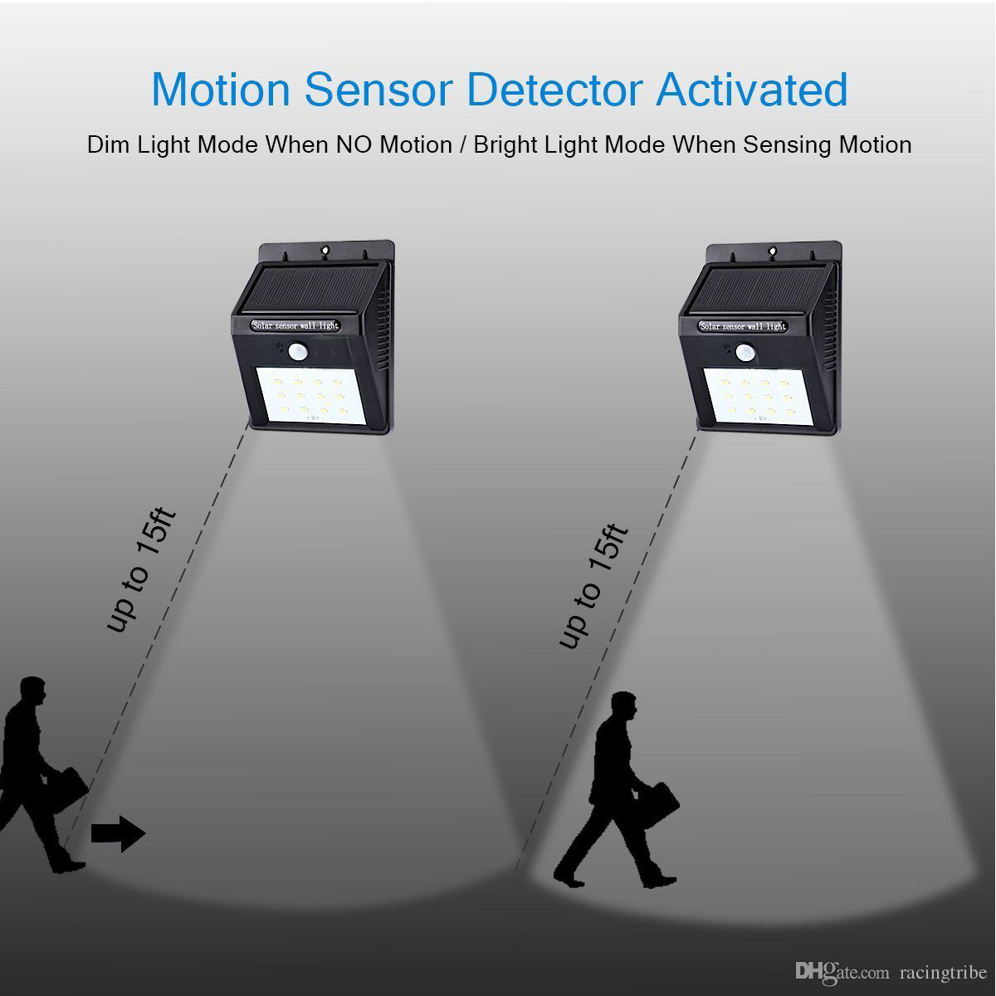
Our future Plan
Our Project can be upgraded with the smartphone control & alarms .
We can use it also in drone .
Our project can be designed for the fire fighting .
We can modify it with the Robot and powerful devices.
It’s a life saving device which can be used for Smart Home automation .

Slide 10
THANK YOU

